Slide 1
The Health Benefits of Nature:
From Gardens to the Planet
Dr Trevor Hancock
Professor and Senior Scholar
School of Public Health and Social Policy
University of Victoria
View Royal Garden Club
23 January 2014

Slide 2
Why nature matters
Biophilia
Dependence on ecosystems
Modern and largely urban life leads to ‘Nature deficit disorder’
The health benefits of nature
Beauty and health – a new idea
Parks and gardens matter

Slide 3
Biophilia
“the connections that human beings subconsciously seek with the rest of life.”
E.O. Wilson
We may have an innate need for nature
We evolved in natural environments
  We seem to have an innate preference for the savannah

Slide 4
What are healthy human habitats
Habitat selection theory - mobile organisms will prefer fit habitats
What environments do humans prefer?
  Based on 25 years of landscape preference research - environments incorporating natural/green elements
    Esp savannah, low plants, depth of view etc - the landscape in which we evolved
Organisms housed in unfit habitats experience social, psychological and physical breakdown
  Based on Ming Kuo’s presentation
  at Healthy by Nature, 22 Sept 2011
Notes:
Based on Ming Kuo’s presentation at Healthy by Nature, 22 Sept 2011, which was based on
Kuo, Frances E. (Ming) (2010) Parks and Other Green Environments: Essential Components of a Healthy Human Habitat Ashburn, VA: National Recreation and Park Association

Slide 5
The ecological determinants of health
“Nature's goods and services are the ultimate foundations of life and health, even though in modern societies this fundamental dependency may be indirect, displaced in space and time, and therefore poorly recognized.”
Ecosystems and Human Well-being
Millennium Ecosystem Assessment
WHO, 2005

Slide 6
Healthy people need healthy ecosystems
“Ecosystems are the planet's life-support systems - for the human species and all other forms of life. Human biology has a fundamental need for food, water, clean air, shelter and relative climatic constancy.”
Ecosystems and Human Well-being
Millennium Ecosystem Assessment, WHO, 2005

Slide 7
But ecosystems are in decline
“Human activity is putting such a strain on the natural functions of Earth that the ability of the planet’s ecosystems to sustain future generations can no longer be taken for granted. . . .
Nearly two thirds of the services provided by nature to humankind are found to be in decline worldwide.”
Millennium Ecosystem
Assessment, 2005
Notes:
Millennium Ecosystem Assessment. (2005b) Living beyond
our means: natural assets and human wellbeing (statement
from the Board). www.maweb.org/documents/
document.429.aspx.pdf (8 August 2011, downloaded).

Slide 8
What proportion of time do we spend . . .
In an urban setting?
80%
Indoors?
90%
In vehicles
5%
Outdoors?
5%
Within a natural ecosystem?

Slide 9
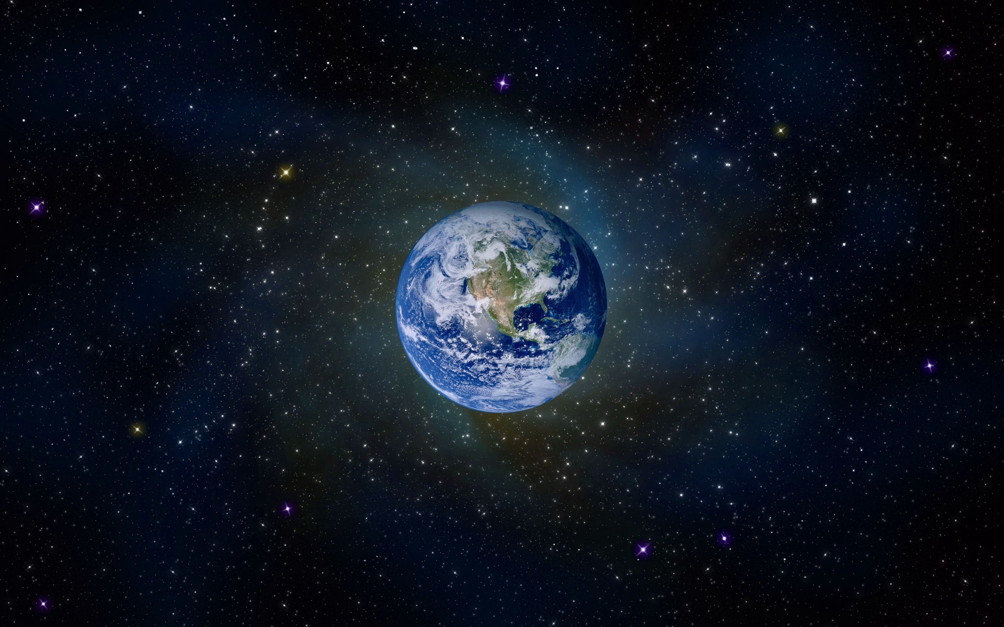
100% of the time

Slide 10
We no longer live in nature
We are 80% urbanised
We spend 90% of our time indoors
  And 5% in vehicles
So we are only outdoors 5% of the time (= 1 hour/day)
  And 80% of that is in urban settings
Kids don’t go out and play

Slide 11

Nature deficit disorder
From the 2005 book
“Last Child in the Woods” by Richard Louv

Slide 12
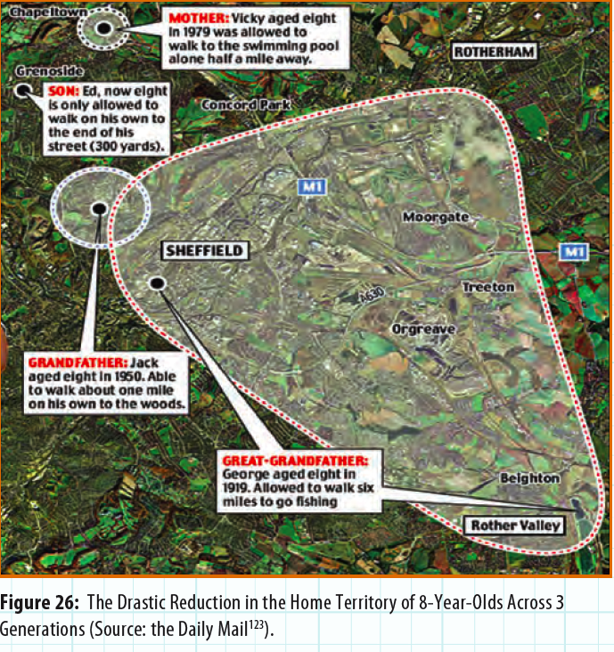
Roaming distance has shrunk
Even as our connectivity to and travel in the wide world has grown!
Who knew more about their community?
Notes:
How children lost the right to roam in four generations by DAVID DERBYSHIRE, Daily Mail, 15 June 2007
http://www.dailymail.co.uk/news/article-462091/How-children-lost-right-roam-generations.html

Slide 13
Time kids spend outdoors
There is little Canadian data
A 2011 US study of self-reported time in 6 – 19 year olds found:
  most children (63%) generally spend at least 2 hours of time outdoors per day
Their reported outdoor time was spent
  playing or just hanging out (84%)
  biking, jogging or running (80%) and
  use of electronic media outdoors (65%)
Source: Active Healthy Kids Canada
2012 Report Card
Notes:
Larson LR, Green GT, Cordell HK (2011). Children’s time outdoors: results and implications of the National Kids Survey. J Park Recreat Admi,29(2):1-20.

Slide 14
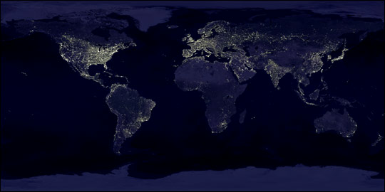
Earth’s City Lights
Data courtesy Marc Imhoff of NASA GSFC and Christopher Elvidge of NOAA NGDC. Image by Craig Mayhew and Robert Simmon,NASA GSFC
Notes:
http://earthobservatory.nasa.gov/Newsroom/NewImages/Images/earth_lights.jpg

Slide 15
If we can’t see the stars . . .
Two-thirds of the U.S. population and more than one-half of the European population have already lost the ability to see the Milky Way with the naked eye.
The first World Atlas of the
artificial night sky brightness, 2001
“When a 1994 earthquake knocked out the power in Los Angeles, many anxious residents called local emergency centers to report seeing a strange “giant, silvery cloud” in the dark sky. What they were really seeing—for the first time—was the Milky Way, long obliterated by the urban sky glow.”
Chepesiuk, Env Health Persp 2009
Notes:
P. Cinzano, F. Falchi and C.D. Elvidge (2001) The first World Atlas of the artificial night sky brightness Monthly Notices of the Royal Astronomical Society 328(3): 689 – 707
Chepesiuk R 2009. Missing the Dark: Health Effects of Light Pollution. Environ Health Perspect 117(1): A20-A27

Slide 16
. . . how do we know our place in the universe?

Slide 17
The child-nature connection
If we raise a generation of kids with no connection to nature, they won’t understand, respect, cherish, nurture or protect nature

Slide 18
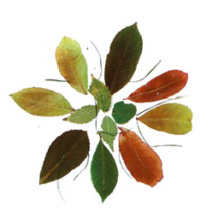
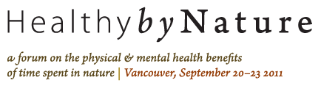
The health benefits of nature

Slide 19
Engaging with nature
Viewing nature
  As through a window, or in a painting
Being in (the presence of nearby) nature
  May be incidental to some other activity
Active participation and involvement with nature
  Countryside Recreation Network (UK)

Slide 20
Viewing nature
. . . has been linked to
Improved recovery in hospital
Reduced stress in prison
Improved student test scores
Reduced job stress, improved job satisfaction
Improved mood, reduced anger
  ‘Relaxed wakefulness’, ‘effortless attention’
Healthy Parks, Healthy People, 2002

Slide 21
Being in nature
. . . has been linked to
A calming affect - relaxed and peaceful, positive mood
Reduced mental fatigue and exhaustion
“the natural environment has been found to have a restorative quality, particularly for people who live in urban environments. Natural places such as parks offer an opportunity to become revitalised and refreshed.”
Increased physical activity
Healthy Parks, Healthy People, 2002

Slide 22
Health and social benefits of urban greenery
Landscape and Human Health Laboratory, U of Illinois -
Frances Kuo and colleagues
Multiple studies of vegetation, mainly in public housing in Chicago
http://lhhl.illinois.edu/

Slide 23
The health impacts of ‘less green’ environments
Social breakdown
  Less strength of community, courtesy, mutual support, supervision of children outdoors
  More loneliness, graffiti, noise, litter, loitering, illegal activity, property crime, aggression, violence, violent crime
Psychological breakdown
  Less attention, learning, management of major life issues, impulse control, delay of gratification
    Greener schools related to better scores, greening schools leads to improved scores
  More ADHD symptoms, clinical depression, anxiety attacks

Slide 24
Physical breakdown
  Poorer recovery from surgery, self-reported physical health, immune functioning
  More obesity in children, physician-diagnosed diseases, mortality
Strength of evidence
  Based on hundreds of studies involving millions of people
  Multiple methodologies, multiple outcomes
  Many diverse populations
  Based on Ming Kuo’s presentation
  Healthy by Nature, 22 Sept 2011 and on
  Kuo, (2010) Parks and Other Green Environments:
  Essential Components of a Healthy Human Habitat
  (National Recreation and Park Association)
Notes:
Kuo, Frances E. (Ming) (2010) Parks and Other Green Environments: Essential Components of a Healthy Human Habitat Ashburn, VA: National Recreation and Park Association

Slide 25
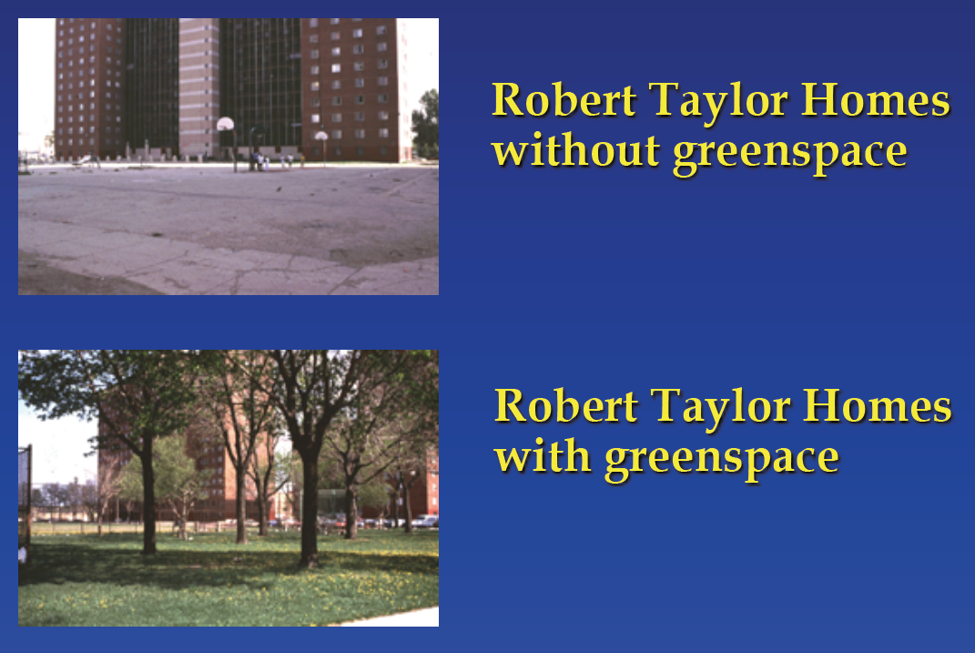
Notes:
Source: Ming Kuo

Slide 26
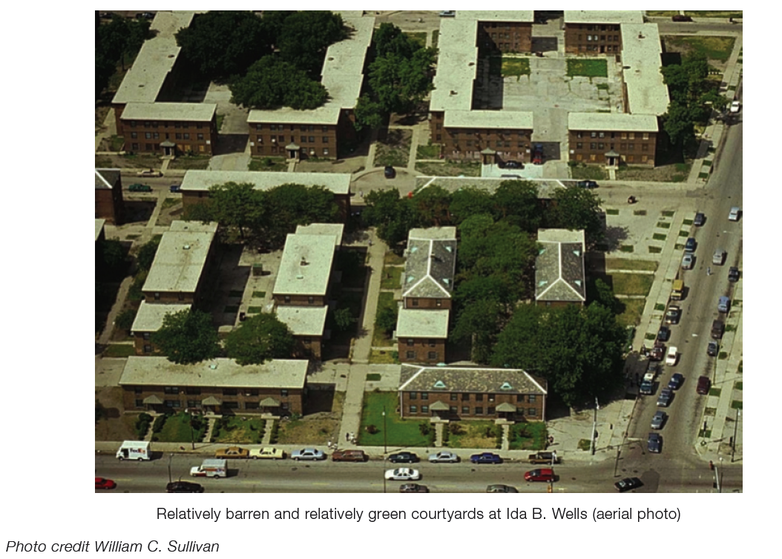
Notes:
Source: Kuo, Ming (2010) Parks and Other Green Environments: Essential Components of a Healthy Human Habitat (Executive Summary) Ashburn, VA: Natioanl Recreation Association

Slide 27
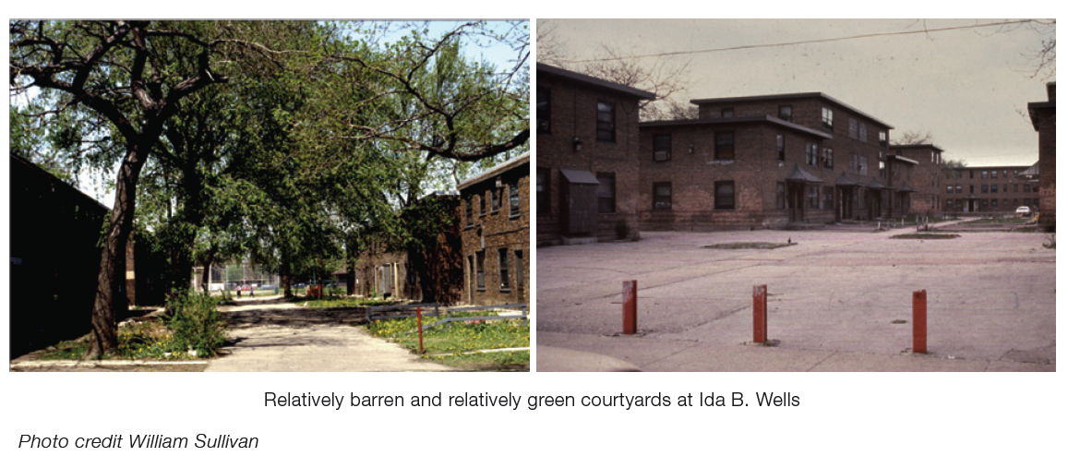
Notes:
Source: Kuo, Ming (2010) Parks and Other Green Environments: Essential Components of a Healthy Human Habitat (Executive Summary) Ashburn, VA: Natioanl Recreation Association

Slide 28
Ming Kuo’s research
The greater the amount of greenery in common spaces, the higher the levels of mutual caring and support among neighbours
The higher the amount of vegetation, the lower the crime rate
Higher levels of residential greenery are associated with lower levels of aggression against domestic artners

Slide 29
Ming Kuo’s research/2
The more natural the view from home, the better girls scored on tests of concentration and self-discipline
The more greenery, the higher levels of optimism and sense of effectiveness
The greener the setting in which children with ADD spend time, the more their symptoms are relieved

Slide 30
‘Vitamin G’
If this was a drug, we would call it a miracle drug!

Slide 31
Because we are so urbanised
The challenge is not how to get people to nature, but how to get nature to people – in the settings where they live, learn, work and play
Home
School
Neighbourhood
Work
Hospital

Slide 32
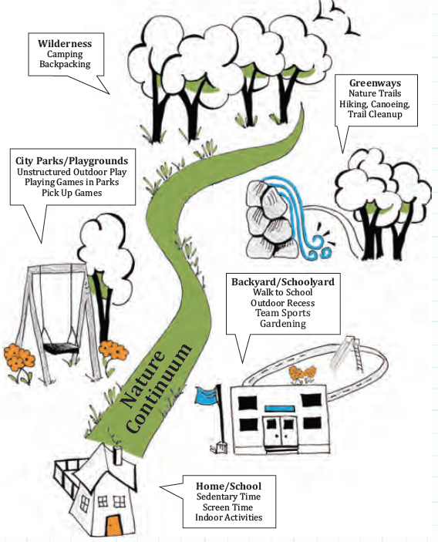
The Different Environments of Nature and the Different Ways Children and Youth Can Experience Nature
(Adapted From the Child and Nature Alliance)
Source: Active Healthy Kids Canada (2011)The Active Healthy Kids Canada 2011 Report Card on Physical Activity for Children and Youth. Toronto: Active Healthy Kids Canada.
(p 52)
Notes:
Source: Active Healthy Kids Canada (2011). Don’t Let This Be The Most Physical Activity Our Kids Get After School. The Active Healthy Kids
Canada 2011 Report Card on Physical Activity for Children and Youth. Toronto: Active Healthy Kids Canada. (p 52)

Slide 33
Health benefits of interacting with plants
The ability to facilitate healing in the elderly and mentally disadvantaged
Improving mental capacity and productivity of people working in offices
Improving job and life satisfaction of residents
Attracting consumers and tourists to shopping districts, and
Aiding community cohesion and identity
Healthy Parks, Healthy People, 2002

Slide 34
Nature at home
Potted plants
Balcony gardens
Gardens

Slide 35
Health benefits of gardens and gardening
Restorative effect of nature
Physical activity
Social interaction
  Gardening clubs
  Community gardens

Slide 36
Nature at School: Forest Schools & Nature KG
Forest School is an educational approach that fosters a connection to, and knowledge of, the natural world through repeated, regular access to local woodland areas, parks and outdoor classrooms through the lens of play-based and child-directed learning.
          http://www.forestschoolcanada.ca/
Sooke SD 61 Nature KG
http://naturekindergarten.sd62.bc.ca/

Slide 37
School grounds and gardens
Benefits for students
Educational benefits
Environmental stewardship and connection with nature
Lifestyle and Nutrition
Benefits for teachers, schools and communities
Active learning and student engagement
Student attention and class management
Teachers as gardeners
Connection to history and the community
School pride
Source: Tampa Bay School Gardening Network.
http://web3.cas.usf.edu/tbsg/benefitsofschoolgardening.aspx

Slide 38
Evergreen Foundation - Greening School Grounds
Mission - To inspire and enable action to green cities.
Brings more than 20 years of experience greening school grounds across Canada
http://www.evergreen.ca/en/programs/children/

Slide 39
Nature in the neighbourhood
Street trees
Neigbourhood gardens
Street gardens
Institutional greenery
Guerrilla gardening
Community gardens
Parks
Etc.

Slide 40
Urban trees and health
The four main ways that urban trees affect air quality are:
Temperature reduction and other microclimatic effects
Removal of air pollutants
Emission of volatile organic compounds and tree maintenance emissions
Energy effects on buildings
David J. Nowak
USDA Forest Service, Syracuse, NY
http://www.fs.fed.us/ne/syracuse/TREE%20Air%20Qual.pdf

Slide 41
Health benefits of community gardening
Increase community cohesion
  across cultures
  across generations
  reduce graffiti and violence
Increase knowledge of nature, food
Increase access to healthy food
Create restorative spaces
Give residents a more positive attitude about themselves and their neighbourhood, resulting in personal and neighbourhood transformation
(Based on Healthy Parks, Healthy People, 2002)

Slide 42
Health benefits of urban parks
Physical (exercise)
Social (being with others)
Mental/emotional (relaxation, etc)
Spiritual (connecting with nature)
Ecological (air quality, temperature regulation etc)

Slide 43
Parks for all
Given the inequalities in health we face, how do we ensure the most disadvantaged get the benefits that ‘Vitamin G’ offers?
How do parks meet the needs of ethno-racially diverse communities?
Age–friendly parks?
How do we bring nature indoors?

Slide 44
Nature at work
Plants, gardens
Daylight
Green walls, green roofs
  Linked to increases in productivity
Bio-walls (U of Guelph-Humber)
“Living machine” sewage treatment
  Body Shop, Toronto

Slide 45
Nature in hospitals
Views
  Pictures
  Windows (Ulrich, 1984)
Plants, fountains
  Even in an ICU
Healing gardens (esp trees, greenery, flowers, water)
  Reduce stress, improve mood, increase satisfaction (patients, families and staff)
Pets
See www.Planetree.org

Slide 46
Beauty and health
What links
Art
Nature
Cities and the built environment
BEAUTY!

Slide 48
My early thoughts
Every culture has decorative art, music, dance, jewelry
Every culture has ideas of beauty and seeks to create beauty
So it seems beauty is fundamental to human societies and culture
That suggests to me that beauty is likely to be good for health and social wellbeing

Slide 49
Ahhh, but what is beauty?
“Beauty is in the eye of the beholder”
Challenging, perhaps even dangerous ground

Slide 50
The quality present in a thing or person that gives intense pleasure or deep satisfaction to the mind, whether arising from sensory manifestations (as shape, color, sound, etc.), a meaningful design or pattern, or something else (as a personality in which high spiritual qualities are manifest).
Dictionary.com

Slide 51
“That which stirs the soul”
Ann Petrie, Artist &
former CBC broadcaster
That which “brings you joy”
Susanne Sklar, Academic &
William Blake scholar
“that which makes life worth living. Any society that doesn’t respect deep pleasure or satisfaction to the mind is a mean society.”
Peter Schjeldahl
Art critic
All from Beauty Will Save the World
Ideas, CBC Radio,
Thursday, June 10, 2010

Slide 52
Surely something that
gives intense pleasure or deep satisfaction to the mind
Stirs the soul
Brings joy
Makes life worth living
has got to be good for mental health, and since mental and physical health are intimately connects, good for overall health
Note – this probably includes good sex and
rock’n’roll, but I don’t believe it includes
addictive and ultimately destructive
drugs, or violence against others

Slide 53
If so, when we build housing and schools and workplaces and hospitals and neighbourhoods that are ugly, what are we telling the people who live, learn, work or play in those places?

Slide 54
Natural beauty is free
Flowers, trees, etc.
Sunsets, moonbeams,
Lakes, rivers, ponds, oceans
Critters
The wind in the trees
The Milky Way

Slide 55
Gardens, beauty and health
Gardens unite
Nature ('free' beauty)
Art (created beauty) and
The built environment (built beauty)
And have
Physical
Mental
Social
Emotional and
Aesthetic benefits for health

Slide 56
“Build me a garden to grow people in”
James Rouse
Developer of Columbia MD

